Slide 1
Chapter 5: CPU Scheduling

Slide 2
CPU Scheduler
The CPU scheduler selects from among the processes in ready queue, and allocates the a CPU core to one of them
  Queue may be ordered in various ways
CPU scheduling decisions may take place when a process:
  1. Switches from running to waiting state
  2. Switches from running to ready state
  3. Switches from waiting to ready
  Terminates
Scheduling under 1 and 4 is nonpreemptive
All other scheduling is preemptive
  Consider access to shared data
  Consider preemption while in kernel mode
  Consider interrupts occurring during crucial OS activities

Slide 3
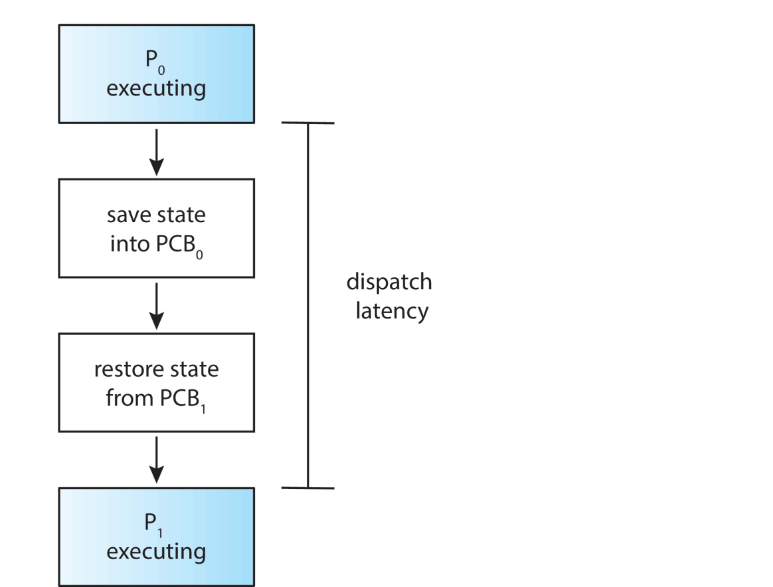
Dispatcher
Dispatcher module gives control of the CPU to the process selected by the short-term scheduler; this involves:
  switching context
  switching to user mode
  jumping to the proper location in the user program to restart that program
Dispatch latency – time it takes for the dispatcher to stop one process and start another running

Slide 4
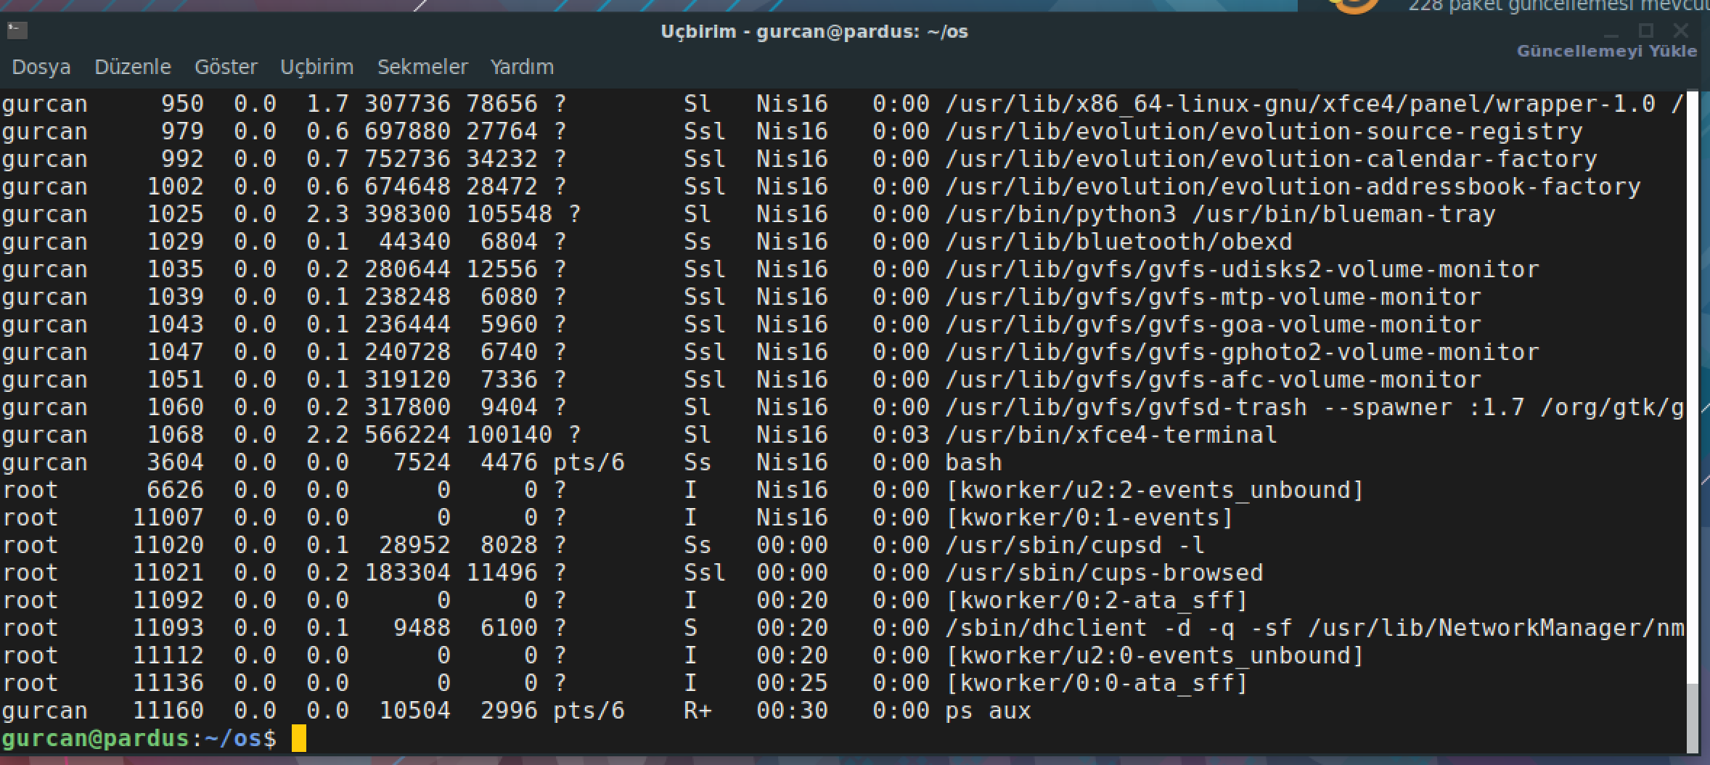
Example : context switch

Slide 5
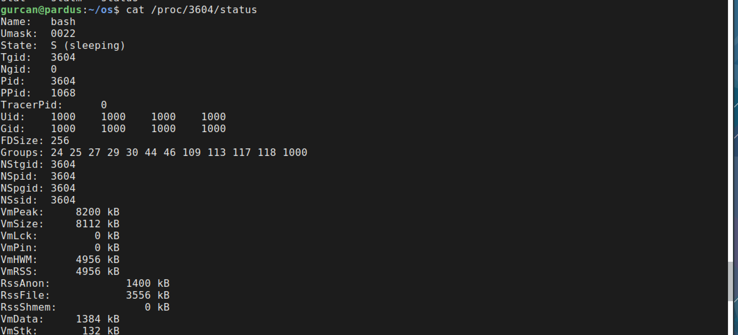
Example : context switch

Slide 6
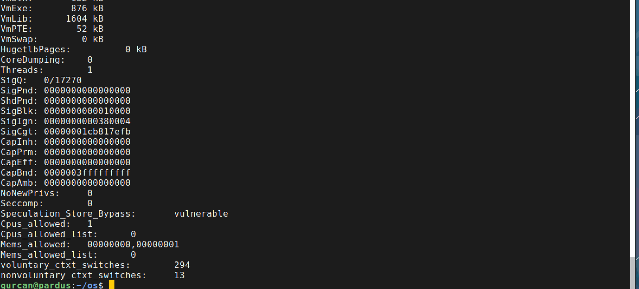
Example : context switch
Voluntary
Nonvoluntary

Slide 7
Scheduling Criteria
CPU utilization – keep the CPU as busy as possible
Throughput – # of processes that complete their execution per time unit
Turnaround time – amount of time to execute a particular process
Waiting time – amount of time a process has been waiting in the ready queue
Response time – amount of time it takes from when a request was submitted until the first response is produced, not output (for time-sharing environment)

Slide 8
Scheduling Algorithm Optimization Criteria
Max CPU utilization
Max throughput
Min turnaround time
Min waiting time
Min response time

Slide 9

First- Come, First-Served (FCFS) Scheduling
Process Burst Time
P₁ 24
P₂ 3
P₃ 3
Suppose that the processes arrive in the order: P₁ , P₂ , P₃
The Gantt Chart for the schedule is:
Waiting time for P₁ = 0; P₂ = 24; P₃ = 27
Average waiting time: (0 + 24 + 27)/3 = 17

Slide 10

FCFS Scheduling (Cont.)
Suppose that the processes arrive in the order:
P₂ , P₃ , P₁
The Gantt chart for the schedule is:
Waiting time for P₁ = 6; P₂ = 0; P₃ = 3
Average waiting time: (6 + 0 + 3)/3 = 3
Much better than previous case
Convoy effect - short process behind long process
  Consider one CPU-bound and many I/O-bound processes

Slide 11
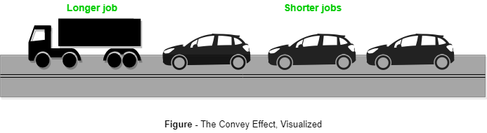
FCFS Scheduling (Cont.)
Convoy effect - short process behind long process
https://www.geeksforgeeks.org/convoy-effect-operating-systems/
Notes:
Convoy Effect is phenomenon associated with the First Come First Serve (FCFS) algorithm, in which the whole Operating System slows down due to few slow processes.
FCFS algorithm is non-preemptive in nature, that is, once CPU time has been allocated to a process, other processes can get CPU time only after the current process has finished
This property of FCFS scheduling leads to the situation called Convoy Effect.
Suppose there is one CPU intensive (large burst time) process in the ready queue, and several other processes with relatively less burst times but are Input/Output (I/O) bound (Need I/O operations frequently)
Hence in Convoy Effect, one slow process slows down the performance of the entire set of processes, and leads to wastage of CPU time and other device
To avoid Convoy Effect, preemptive scheduling algorithms like Round Robin Scheduling can be used – as the smaller processes don’t have to wait much for CPU time – making their execution faster and leading to less resources sitting idle.

Slide 12
Shortest-Job-First (SJF) Scheduling
Associate with each process the length of its next CPU burst
  Use these lengths to schedule the process with the shortest time
SJF is optimal – gives minimum average waiting time for a given set of processes
  The difficulty is knowing the length of the next CPU request
  Could ask the user
Notes:
Shortest job first (SJF) or shortest job next, is a scheduling policy that selects the waiting process with the smallest execution time to execute next. SJN, also known as Shortest Job Next (SJN), is a non-preemptive algorithm.
Shortest Job first has the advantage of having a minimum average waiting time among all scheduling algorithms.
- It is a Greedy Algorithm.
- It may cause starvation if shorter processes keep coming. This problem can be solved using the concept of ageing.

Slide 13

Example of SJF
ProcessArriva l Tim Burst Time
P₁ 0.0 6
P₂ 2.0 8
P₃ 4.0 7
P₄ 5.0 3
SJF scheduling chart
Average waiting time = (3 + 16 + 9 + 0) / 4 = 7

Slide 14


Determining Length of Next CPU Burst
Can only estimate the length – should be similar to the previous one
  Then pick process with shortest predicted next CPU burst
Can be done by using the length of previous CPU bursts, using exponential averaging
Commonly, α set to ½
Preemptive version called shortest-remaining-time-first

Slide 15
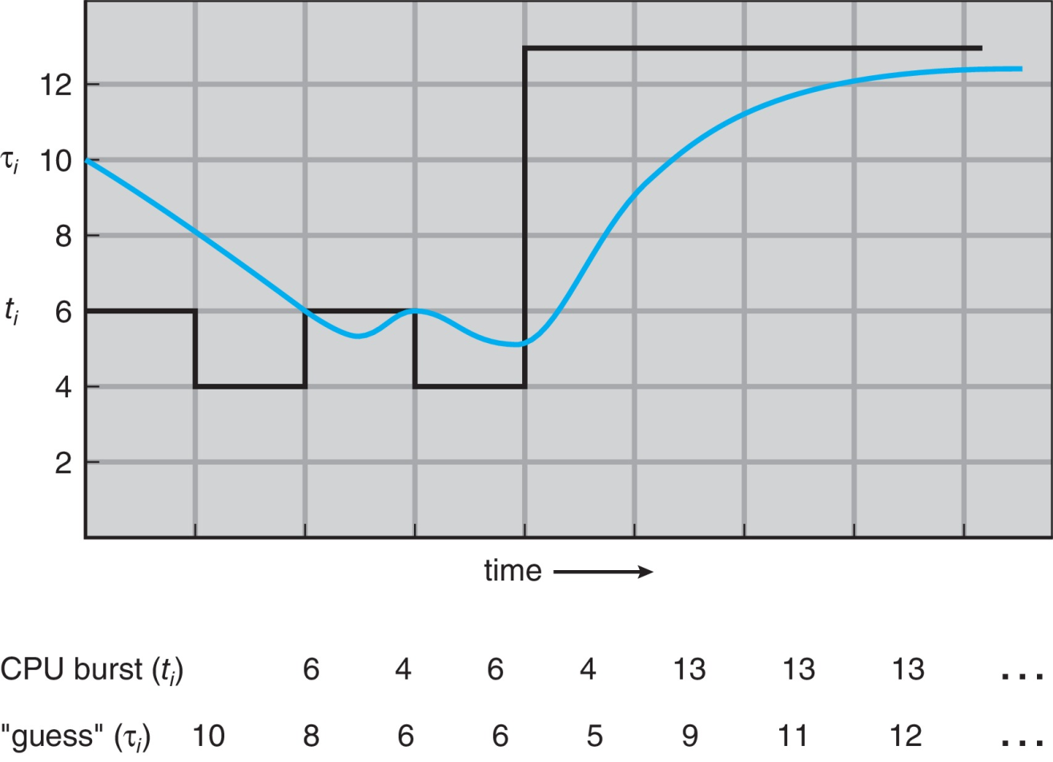
Prediction of the Length of the Next CPU Burst

Slide 16
Examples of Exponential Averaging
α =0
  τ_{n+1} = τ_{n}
  Recent history does not count
α =1
  τ_{n+1} = α t_{n}
  Only the actual last CPU burst counts
If we expand the formula, we get:
    τ_{n+1} = α t_{n}+(1 - α)α t_{n} ₋₁ + …
    +(1 - α )^{j} α t_{n} _{-j} + …
    +(1 - α )^{n +1} τ₀
Since both α and (1 - α) are less than or equal to 1, each successive term has less weight than its predecessor

Slide 17

Example of Shortest-remaining-time-first
Now we add the concepts of varying arrival times and preemption to the analysis
ProcessA Arrival TimeT Burst Time
P₁ 0 8
P₂ 1 4
P₃ 2 9
P₄ 3 5
Preemptive SJF Gantt Chart
Average waiting time = [(10-1)+(1-1)+(17-2)+5-3)]/4 = 26/4 = 6.5 msec
Notes:
In the Shortest Remaining Time First (SRTF) scheduling algorithm, the process with the smallest amount of time remaining until completion is selected to execute. Since the currently executing process is the one with the shortest amount of time remaining by definition, and since that time should only reduce as execution progresses, processes will always run until they complete or a new process is added that requires a smaller amount of time.
Advantage:
1- Short processes are handled very quickly.
2- The system also requires very little overhead since it only makes a decision when a process completes or a new process is added.
3- When a new process is added the algorithm only needs to compare the currently executing process with the new process, ignoring all other processes currently waiting to execute.
Disadvantage:
1- Like shortest job first, it has the potential for process starvation.
2- Long processes may be held off indefinitely if short processes are continually added.

Slide 18
Round Robin (RR)
Each process gets a small unit of CPU time (time quantum q), usually 10-100 milliseconds. After this time has elapsed, the process is preempted and added to the end of the ready queue.
If there are n processes in the ready queue and the time quantum is q, then each process gets 1/n of the CPU time in chunks of at most q time units at once. No process waits more than (n-1)q time units.
Timer interrupts every quantum to schedule next process
Performance
  q large ⇒ FIFO
  q small ⇒ q must be large with respect to context switch, otherwise overhead is too high

Slide 19

Example of RR with Time Quantum = 4
Process Burst Time
P₁ 24
P₂ 3
P₃ 3
The Gantt chart is:
Typically, higher average turnaround than SJF, but better response
q should be large compared to context switch time
q usually 10ms to 100ms, context switch < 10 usec

Slide 20
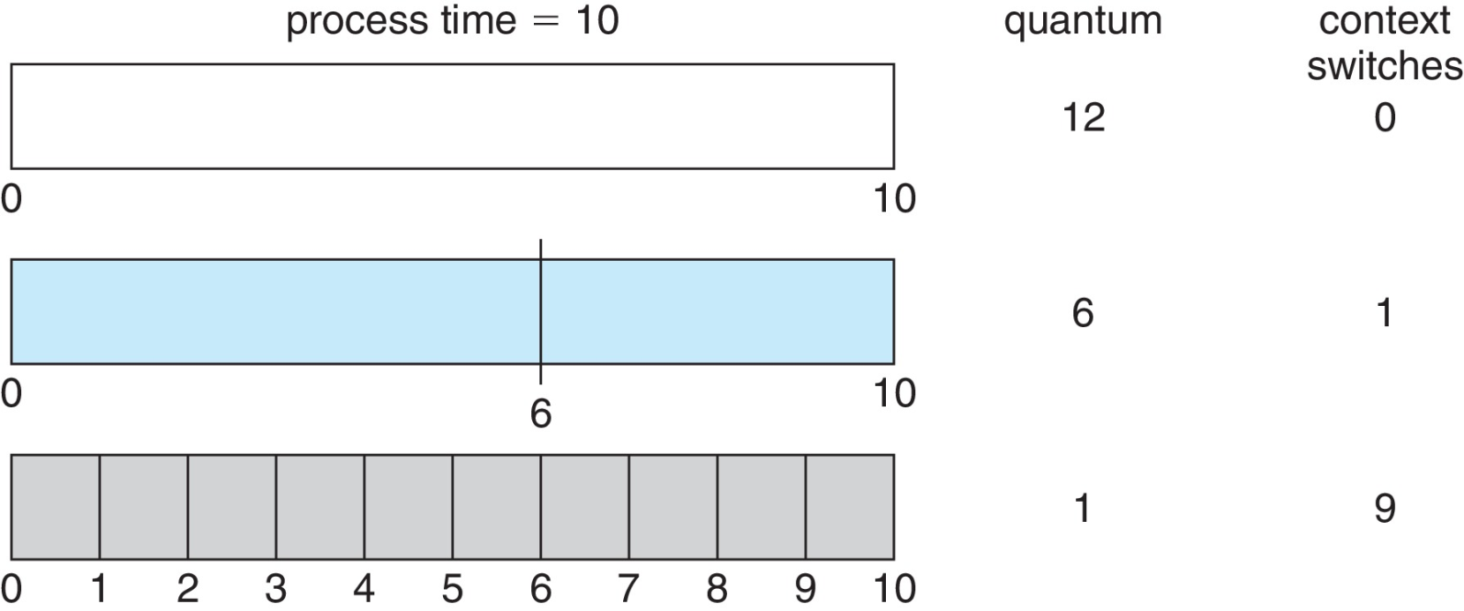
Time Quantum and Context Switch Time

Slide 21
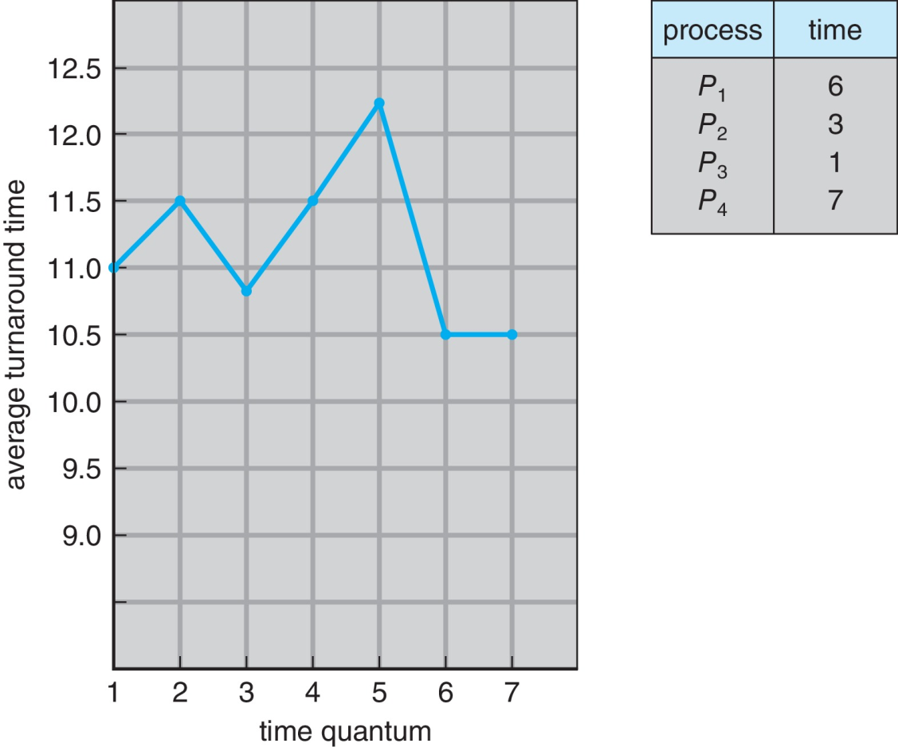
Turnaround Time Varies With The Time Quantum
80% of CPU bursts should be shorter than quantum

Slide 22
Example of RR with Time Quantum = 4
Process Burst Time
P₁ 24
P₂ 3
P₃ 3
The Gantt chart is:
Typically, higher average turnaround than SJF, but better response
q should be large compared to context switch time
q usually 10ms to 100ms, context switch < 10 usec

Slide 23
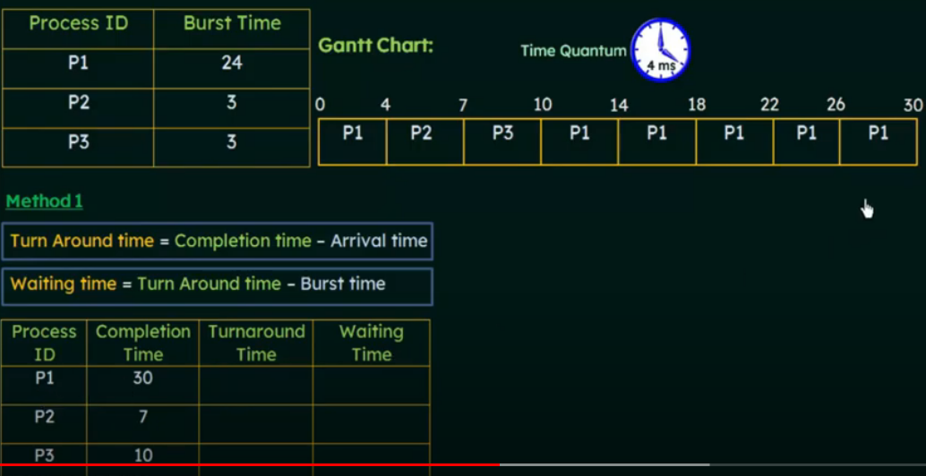
RR Örnek
Kaynak : https://www.youtube.com/watch?v=7TpxxTNrcTg

Slide 24
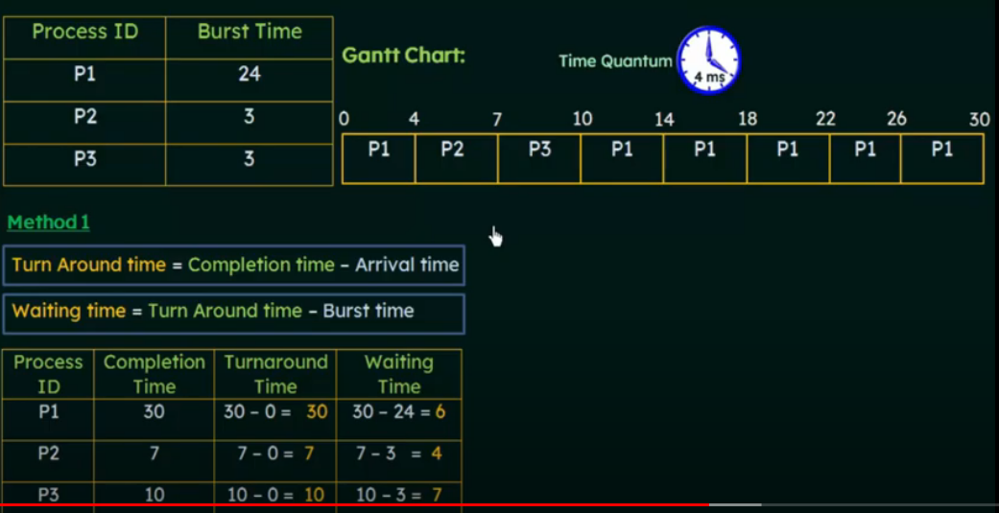
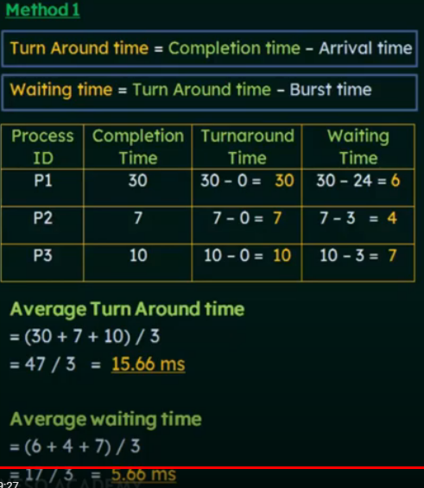
RR Örnek
Kaynak : https://www.youtube.com/watch?v=7TpxxTNrcTg

Slide 25
Priority Scheduling
A priority number (integer) is associated with each process
The CPU is allocated to the process with the highest priority (smallest integer ≡ highest priority)
  Preemptive
  Nonpreemptive
SJF is priority scheduling where priority is the inverse of predicted next CPU burst time
Problem ≡ Starvation – low priority processes may never execute
Solution ≡ Aging – as time progresses increase the priority of the process

Slide 26
Priority Scheduling : Starvation
Starvation or indefinite blocking is phenomenon associated with the Priority scheduling algorithms, in which a process ready to run for CPU can wait indefinitely because of low priority.
In heavily loaded computer system, a steady stream of higher-priority processes can prevent a low-priority process from ever getting the CPU.
There has been rumors that in 1967 Priority Scheduling was used in IBM 7094 at MIT , and they found a low-priority process that had not been submitted till 1973.
Notes:
Starvation or indefinite blocking is phenomenon associated with the Priority scheduling algorithms, in which a process ready to run for CPU can wait indefinitely because of low priority.
In heavily loaded computer system, a steady stream of higher-priority processes can prevent a low-priority process from ever getting the CPU.
There has been rumors that in 1967 Priority Scheduling was used in IBM 7094 at MIT , and they found a low-priority process that had not been submitted till 1973.
Starvation: is when a low priority process does not get access to the resources it needs because there is a high priority process accessing the resources. The entire system of processes hasn't come to halt in this case.

Slide 27
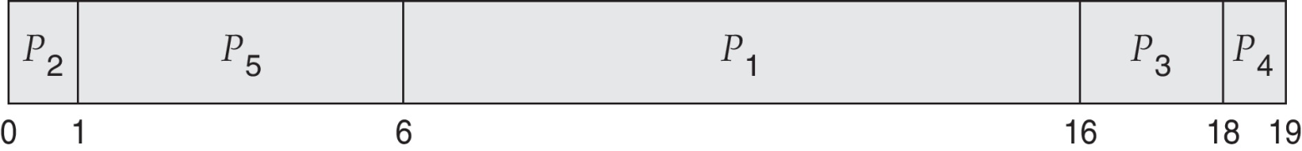
Example of Priority Scheduling
ProcessA arri Burst TimeT Priority
P₁ 10 3
P₂ 1 1
P₃ 2 4
P₄ 1 5
P₅ 5 2
Priority scheduling Gantt Chart
Average waiting time = 8.2 msec

Slide 28
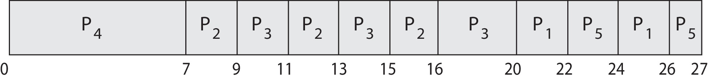
Priority Scheduling w/ Round-Robin
ProcessA arri Burst TimeT Priority
P₁ 4 3
P₂ 5 2
P₃ 8 2
P₄ 7 1
P₅ 3 3
Run the process with the highest priority. Processes with the same priority run round-robin
Gantt Chart wit 2 ms time quantum

Slide 29
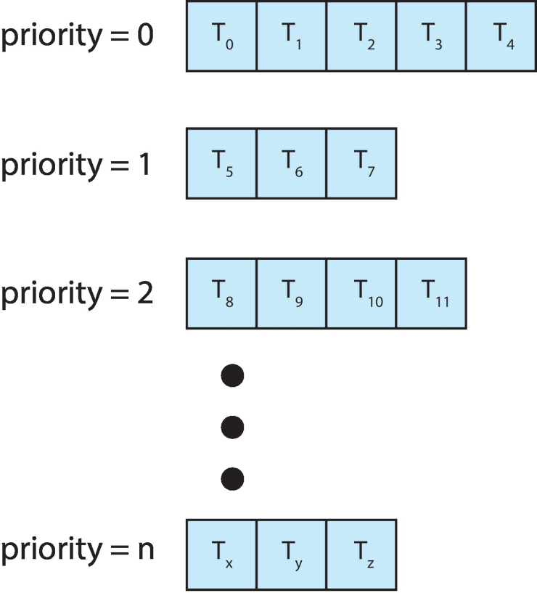
Multilevel Queue
With priority scheduling, have separate queues for each priority.
Schedule the process in the highest-priority queue!
Notes:
- It may happen that processes in the ready queue can be divided into different classes where each class has its own scheduling needs

Slide 30
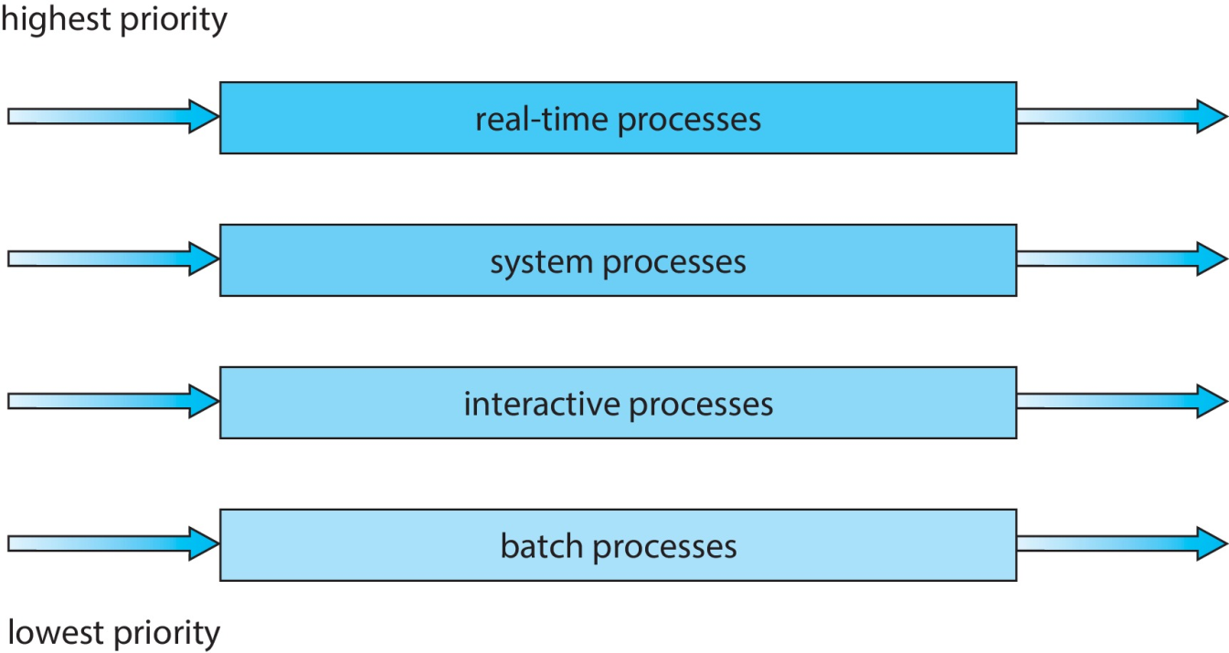
Multilevel Queue
Prioritization based upon process type

Slide 31
Multilevel Feedback Queue
A process can move between the various queues; aging can be implemented this way
Multilevel-feedback-queue scheduler defined by the following parameters:
  number of queues
  scheduling algorithms for each queue
  method used to determine when to upgrade a process
  method used to determine when to demote a process
  method used to determine which queue a process will enter when that process needs service

Slide 32

Example of Multilevel Feedback Queue
Three queues:
  Q₀ – RR with time quantum 8 milliseconds
  Q₁ – RR time quantum 16 milliseconds
  Q₂ – FCFS

Slide 33
Example of Multilevel Feedback Queue
Scheduling
  A new job enters queue Q₀ which is served FCFS
    When it gains CPU, job receives 8 milliseconds
    If it does not finish in 8 milliseconds, job is moved to queue Q₁
  At Q₁ job is again served FCFS and receives 16 additional milliseconds
    If it still does not complete, it is preempted and moved to queue Q₂

Slide 34
End of Chapter 5

